Slide 1
Glaciology EESCGU4220
Practical 4:
Solving the Shallow ice equations with the finite difference method

Slide 2
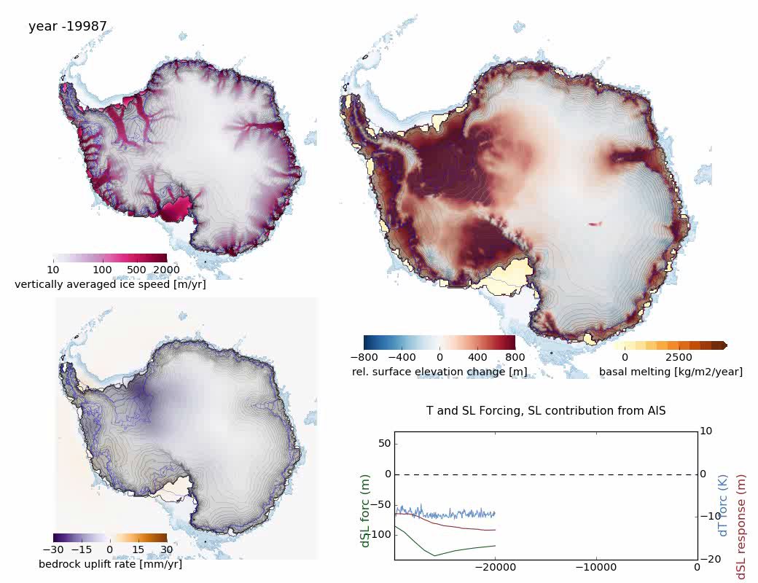
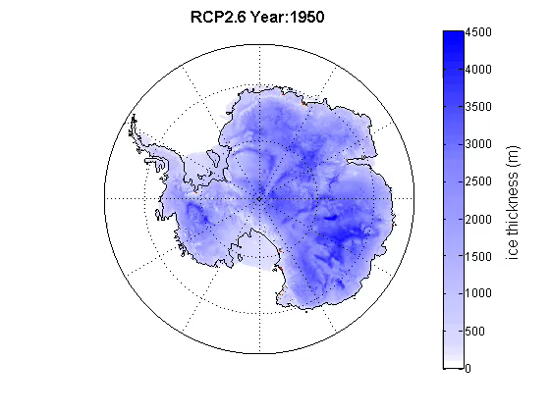
Two state-of-the-art hydrid models
Take into account GIA, ocean/atmosphere forcing, calving, surface mass balance, spatially-variable bed conditions.
DeConto and Pollard (2013)
Kingslake, Albrecht, Scherer, 2018
Penn State University model
Parallel Ice Sheet model (PISM)

Slide 3
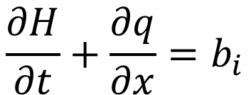
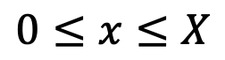
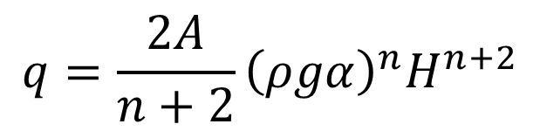
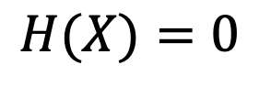
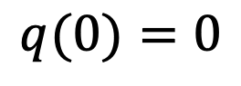
A full Shallow Ice Approximation model:
mass conservation:
$$q={\frac{2A}{n+2}\left(ρgα\right)}^{n}H^{n+2}$$
$$\frac{∂H}{∂t}+\frac{∂q}{∂x}=b_{i}$$
$$q(0)=0$$
$$H(X)=0$$
$$0≤x≤X$$

Slide 4
Choose one:
Start with working code with a few lines removed
2. Start with working code with many lines removed
3. Start with just the structure
4. Start with nothing.
Be ambitious! But we want everyone to have a working code by the start of next week!

